Slide 1

Hypothesis, Correlation and Regression - Green Belt Training Program
_{ADVISORY SERVICES}

Slide 2
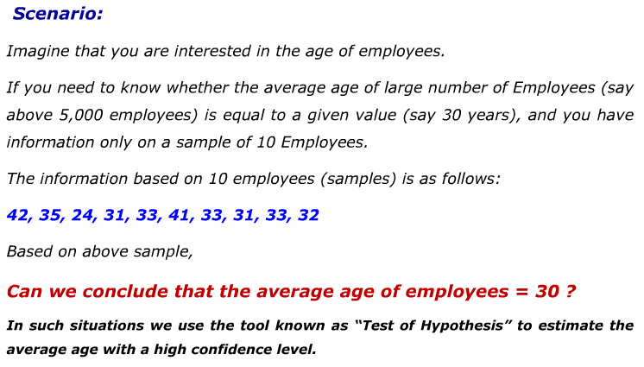
Hypothesis Testing

Slide 3
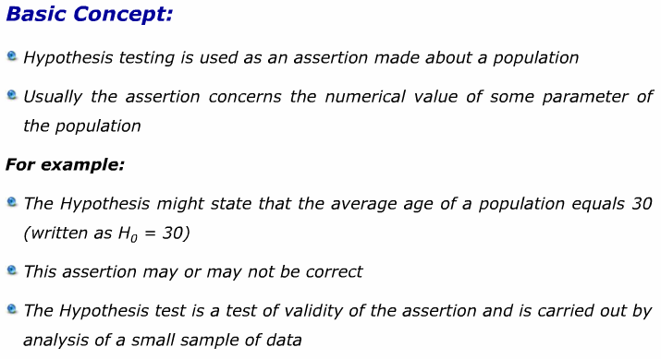
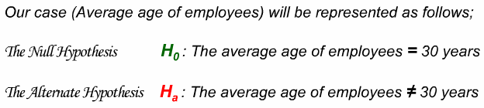
Hypothesis Testing

Slide 4
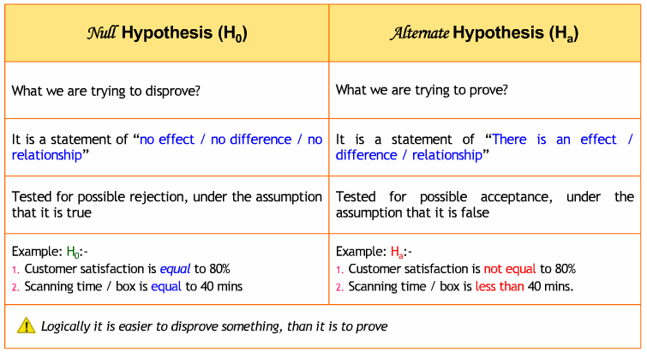
Hypothesis Testing

Slide 5
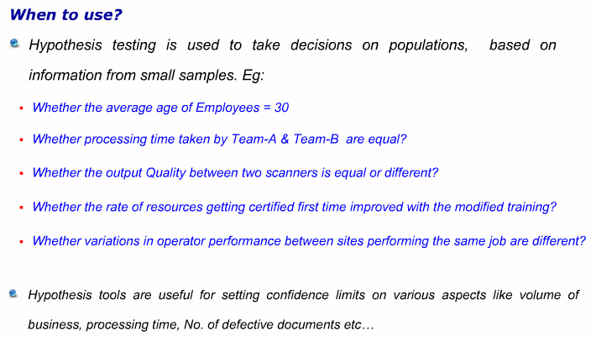
Hypothesis Testing

Slide 6
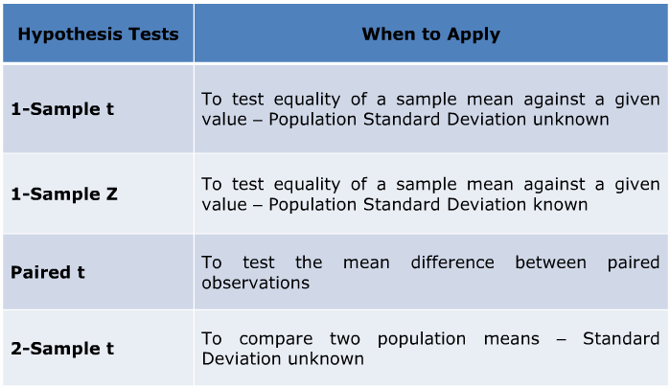
Types of Hypothesis Testing

Slide 7
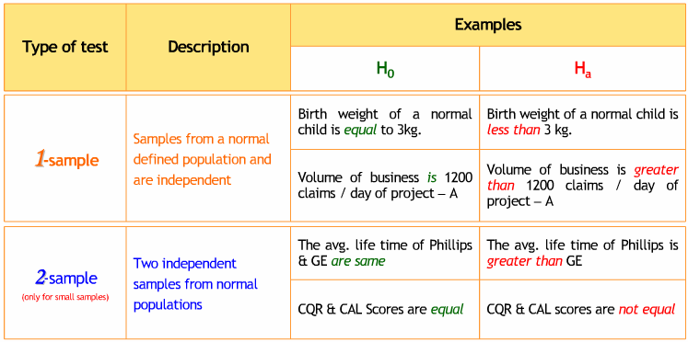
Types of Hypothesis Testing

Slide 8
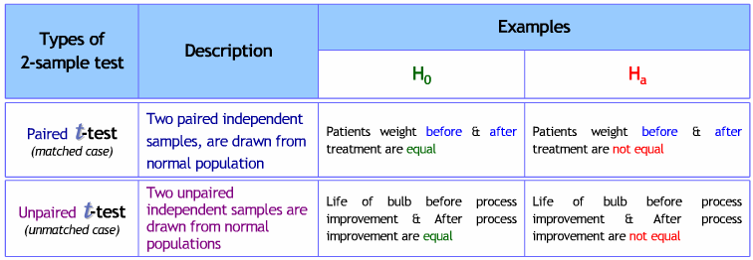
Types of Hypothesis Testing

Slide 9
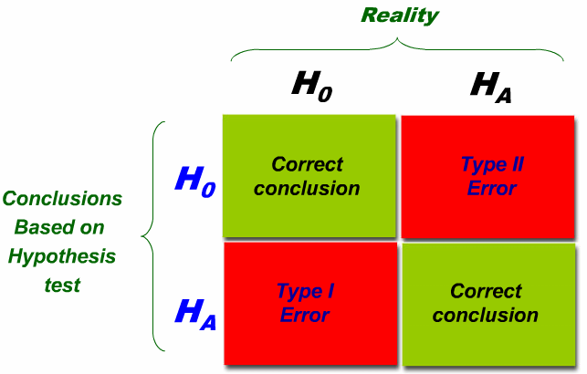
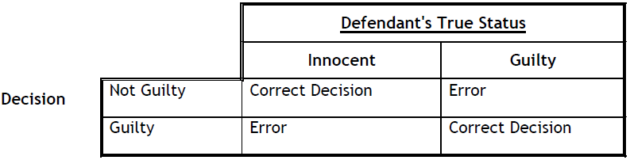
Hypothesis Testing

Slide 10
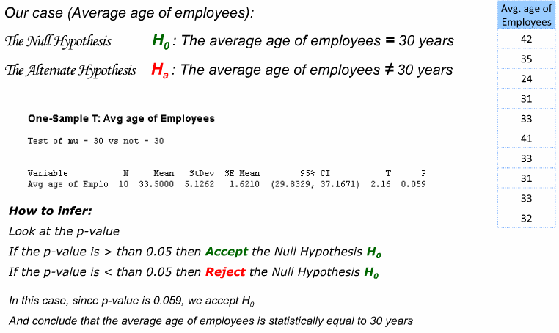
Hypothesis Testing – 1 Sample t

Slide 11
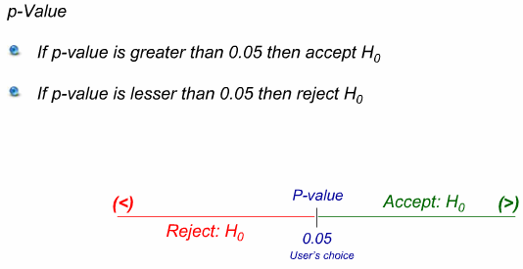
Hypothesis Testing – 1 Sample t

Slide 12
Hypothesis Testing – 1 sample t
A new spark plug design is tested for wear. A sample of six plugs
yielded: 0.0058",0.0049",0.0052",0.0044",0.0050" and 0.0047" of wear. The current design has historically produced an average wear of 0.0055". With 95% confidence is the new design better?

Slide 13
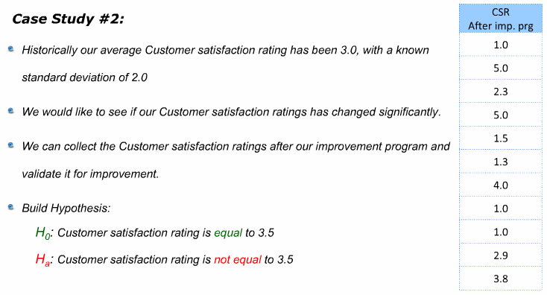
Hypothesis Testing – 1 sample z

Slide 14
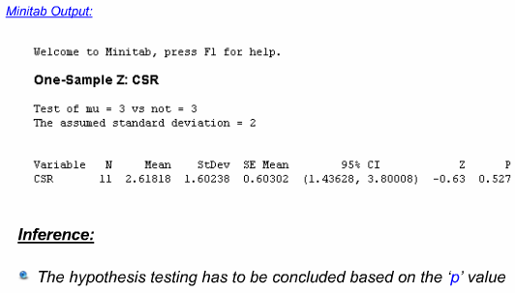

Hypothesis Testing – 1 sample z

Slide 15
Hypothesis Testing – 1 sample z
The average vial height. from an injection molding process has been
5.00" with a standard deviation of 0.12". An experiment is conducted using new material which yielded the following vial heights: 5.10",4.90",4.92",4.87", 5.09",
4.89",4.95", and 4.88".

Slide 16
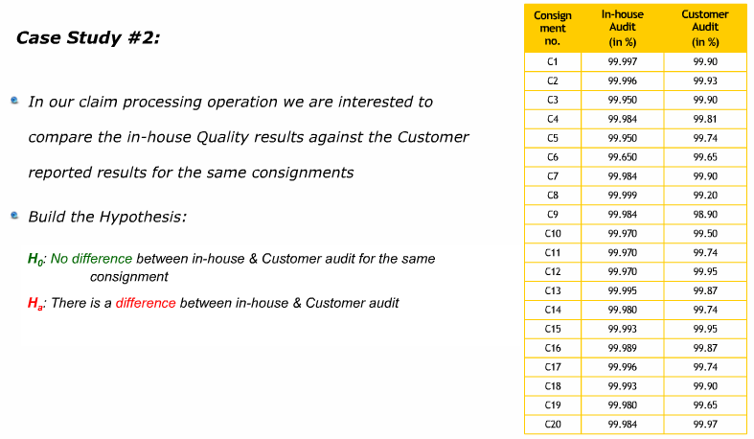
2 Sample t – Paired Data

Slide 17
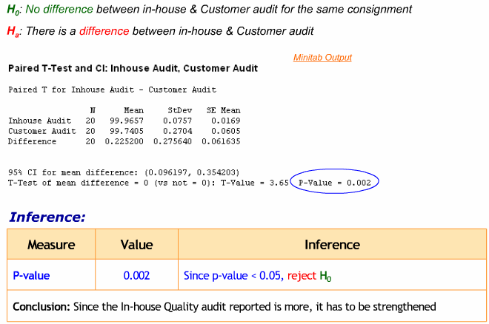
2 Sample t – Paired Data

Slide 18
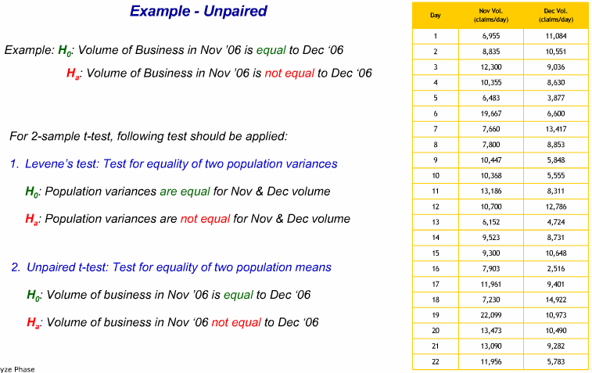
2 Sample t – Unpaired Data

Slide 19
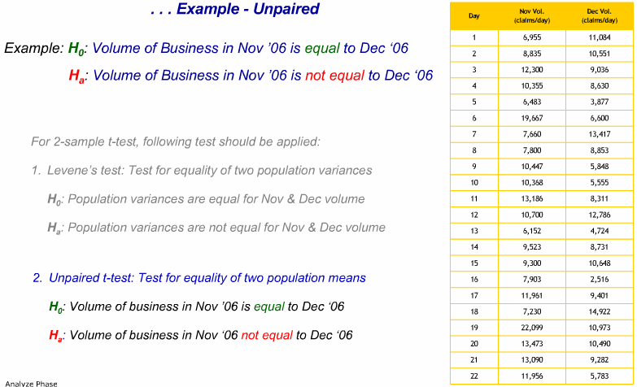
2 Sample t – Unpaired Data

Slide 20
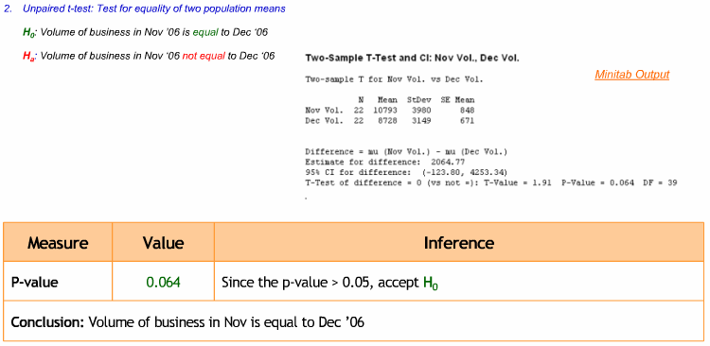
2 Sample t – Unpaired Data

Slide 21
2 Sample t – ANOVA
Suppose the National Transportation Safety Board (NTSB) wants to examine the safety of compact cars, midsize cars, and full-size cars. It collects a sample of three for each of the treatments (cars types). Using the hypothetical data provided below, test whether the mean
pressure applied to the driver’s head during a crash test is equal for each types of car. Use α= 5%.
Table ANOVA.1
Compact cars Midsize cars Full-size cars
643 469 484
655 427 456
702 525 402

Slide 22
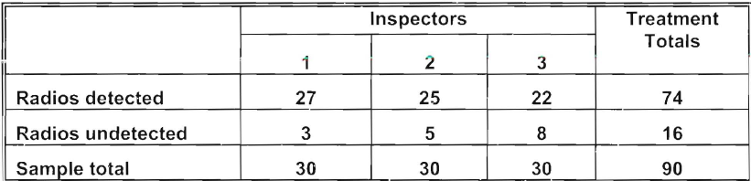
2 Sample t – Chi Square
An airport authority wanted to evaluate the ability of three X-ray inspectors to detect key items. A test was devised whereby transistor radios were placed in ninety pieces of luggage. Each inspector was exposed to exactly thirty of the preselected and "bugged" items in a random fashion. The observed results are summarized below.

Slide 23
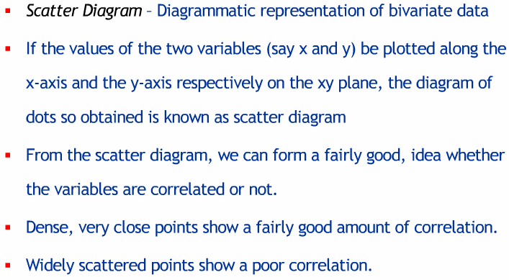
Correlation Analysis

Slide 24
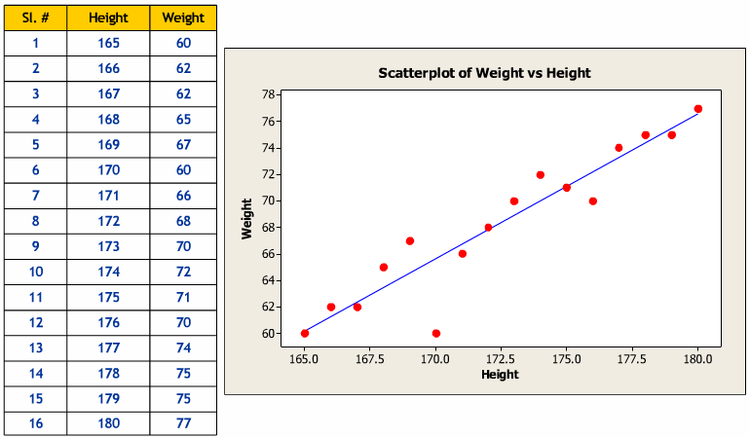
Scatter Plot

Slide 25
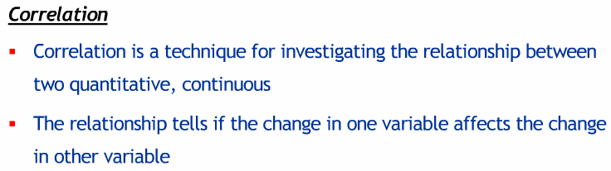
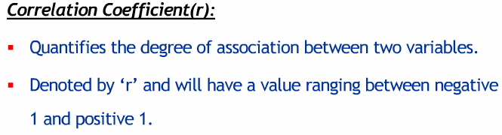
Correlation

Slide 26
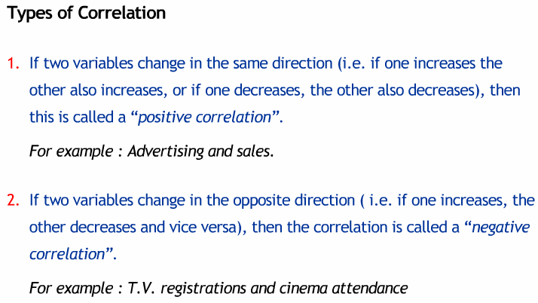
Correlation – Relationship Types

Slide 27
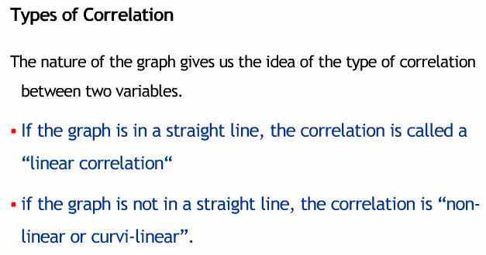
Correlation – Relationship Types

Slide 28
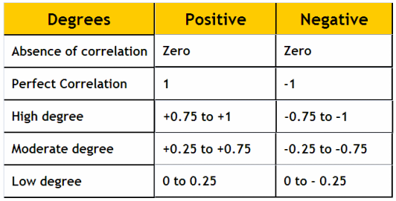
Degree of Correlation

Slide 29
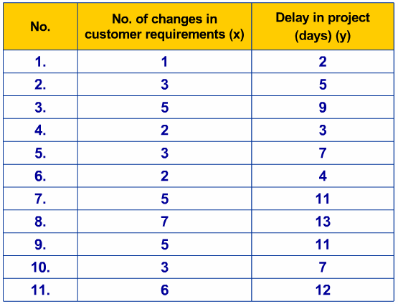
Example

Slide 30
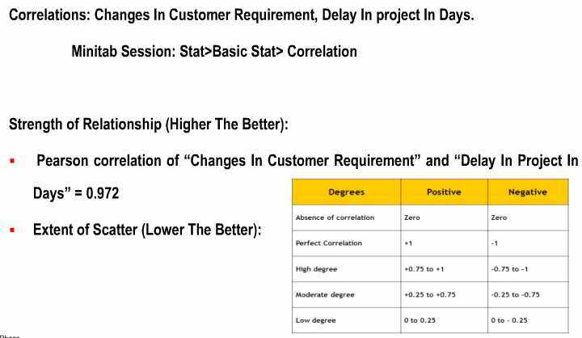
Correlation Analysis

Slide 31
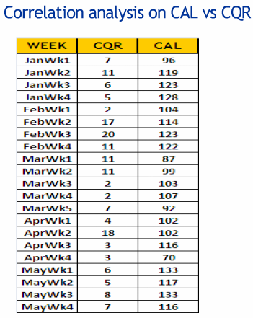
Example

Slide 32
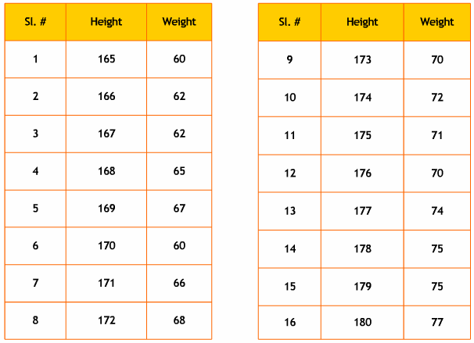
Regression

Slide 33
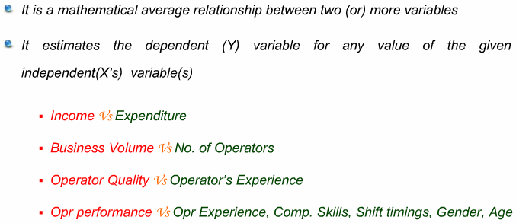
Regression

Slide 34
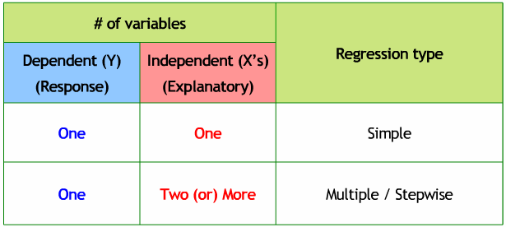
Types of Regression

Slide 35
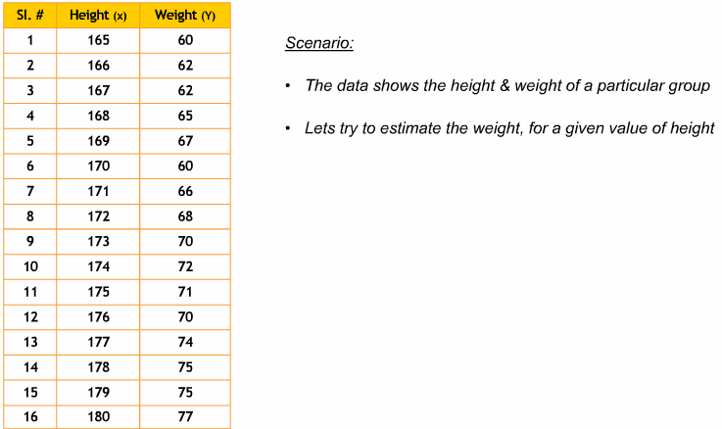
Simple Regression

Slide 36
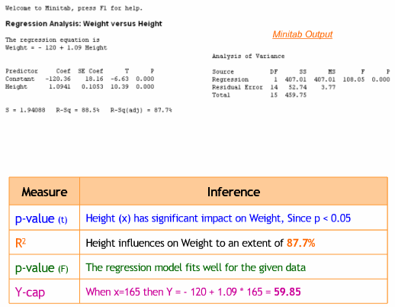
Simple Regression

Slide 37
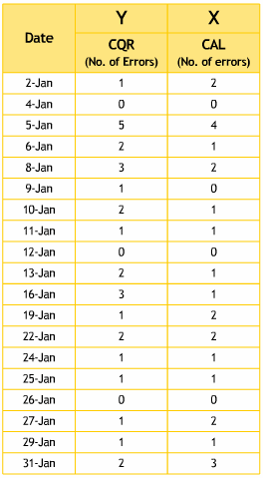
Simple Regression - Example

Slide 38
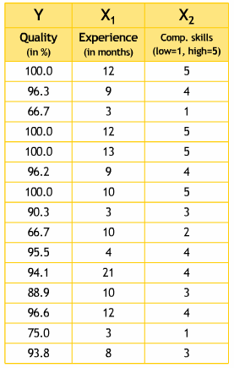
Multiple Regression

Slide 39
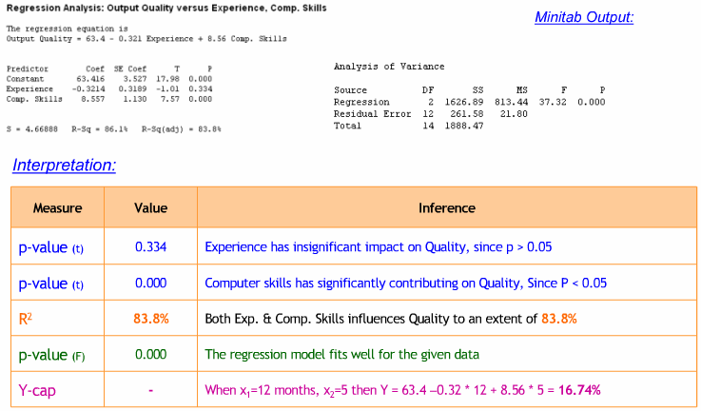
Multiple Regression

